Slide 1




第三届中国Rust开发者大会

Slide 2

Rust China Conf 2023
利用Rust重塑移动应用开发
陈东 Aaron Chen
CTO
AccountLabs
Notes:
大家好，很高兴今天有机会站在这里和大家分享，我们团队在移动端的Rust实践。首先介绍一下我自己，我叫陈东，是Accountlabs CTO。 Accountlabs是一家专注解决Web3世界账户问题的公司。我们现在有两条产品线，一条是Keystone，Keystone是一个离网的设备，主要解决用户的私钥安全问题。另外一条是Unipass，主要解决的是方便的为普通用户提供一个Web3的账户的问题。
今天和大家分享的主题就是我们团队如何利用Rust来改建和重塑我们在移动端开发的问题。

Slide 3
利用Rust重塑移动应用开发
2023 移动应用开发有那些选择？
Native
Flutter
React Native？

Slide 4


利用Rust重塑移动应用开发
跨平台开发的优势和局限性
icon
React Native is an open-source JavaScript framework, designed for building apps on multiple platforms.
Code reusability
Hot reload
Javascript ecosystem
Flutter, is an open source framework by Google for building beautiful, natively compiled, multi-platform applications from a single codebase.
Single codebase
Hot reload
Rendering Engine
Notes:
我就先总结一下介绍一下两种跨平台开发的特点。

Slide 5
利用Rust重塑移动应用开发
Pros:
Fast
Single Codebase
Third-party support (Javascript better than Dart)
跨平台开发的优势和局限性
Cons:
Performance
Native feature utilize
Existing Codebase
Notes:
Fast 适合创业公司快速的构建MVP去市场验证。
单一codebase，一套代码，通过构建工具去构建不同的app
第三方库的支持 RN好与Dart

Slide 6
利用Rust重塑移动应用开发
跨平台开发到到底应该跨什么？
UI or Logic ?
Notes:
1.用同样一套UI去适应不同的平台是否OK？
2.跨平台开发到底想要去开发什么呢？
●
3.例如一个新闻App，提供了IOS和Android的客户端，如果我们抽象出最简单的业务逻辑，他应该是去服务端获取最新的新闻，经过处理，组成一个list，然后展示成为到首页中。这套业务逻辑我们要用swift写一遍，再用Java/Kotlin写一遍，的确是很低效的，有没有什么办法可以让我们只写一遍，但是可以在两个平台。甚至更多的平台上跑呢？。
●
4.所以我们认为，对于这种重业务逻辑的应用，跨平台开发应该是垮的业务逻辑，至于UI可以遵循各个平台上的特点，最佳实践等等用原声语言来开发。

Slide 7
利用Rust重塑移动应用开发
Rust在移动端应用的价值
Rust is the only advanced choice for cross platform development.
Notes:
C/C++/ Rust

Slide 8
利用Rust重塑移动应用开发
Why Rust?
Cross platform
Performance
Thread Safe
Memory Safe
Love
Rust的特点

Slide 9
利用Rust重塑移动应用开发
Why Rust?
Cross platform
Performance
Memory Safe
Love
Rust在移动应用开发中的应用

Slide 10

利用Rust重塑移动应用开发
Keystone
Keystone is aiming to develop the most secure and easyuse hardware wallet for the Web3 world
PhoTto / image / chart

Slide 11
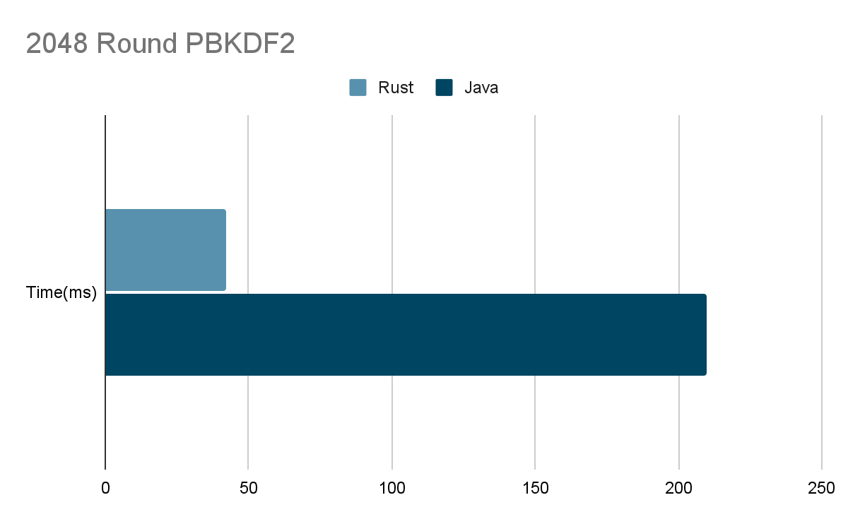
利用Rust重塑移动应用开发
采用Rust重构业务逻辑的背景和动机
Performance
Keystone App is a mobile application developed with React native. Due to some computationally intensive tasks, using Javascript is very poor. Therefore, we plan to use Rust to provide high performance
Photo / image / chart
Share Logic
The same business logic will run on different platforms such as embedded devices, IOS, Android, etc. It is an inevitable choice for our business to choose a language that can support multiple platforms.

Slide 12
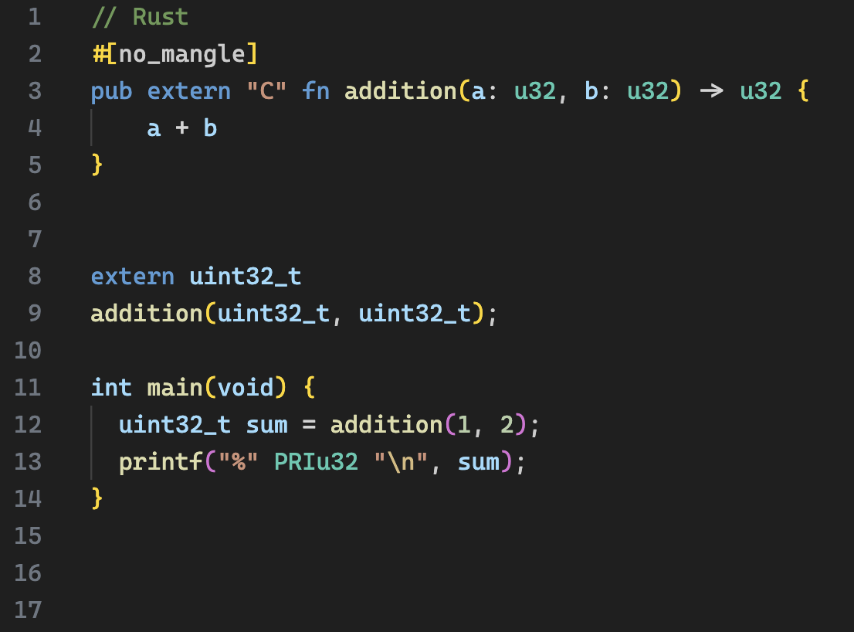
利用Rust重塑移动应用开发
Rust FFI
Rust FFI (Foreign Function Interface) refers to the ability of Rust programming language to interface with code written in other languages, typically C or C++. FFI allows Rust to call functions and use data structures defined in other languages, and vice versa.
2);
Photo / image / chart

Slide 13
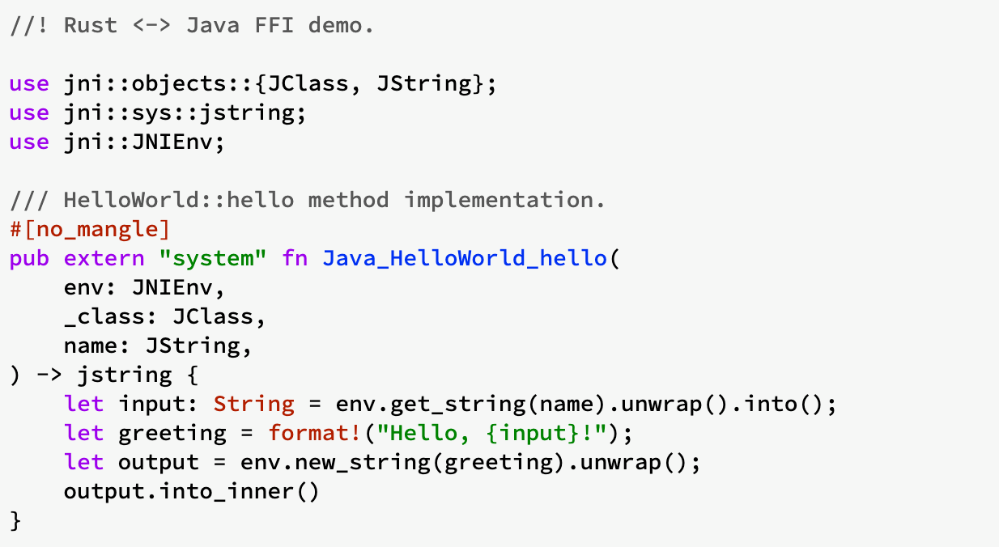
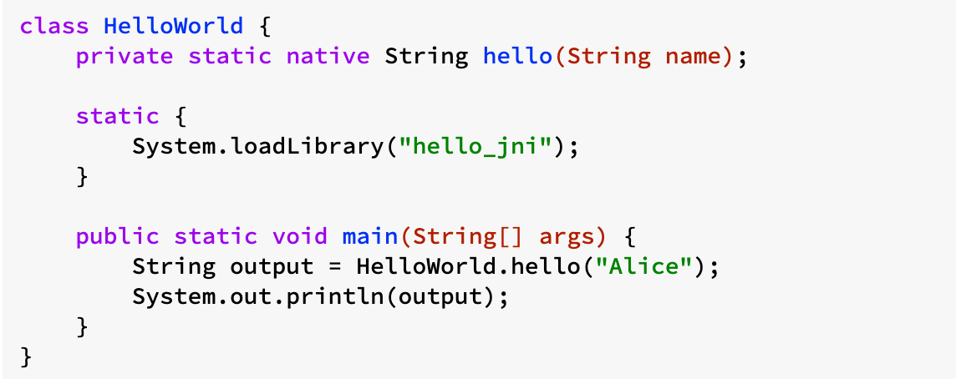
利用Rust重塑移动应用开发
Rust FFI on Android
NDK
The Android NDK is a toolset that lets you implement parts of
your app in native code, using languages such as C and C++. For certain types of apps, this can help you reuse code libraries written in those languages.
JNI
JNI is an interface that allows Java to interact with code written in another language. Motivation for JNI is code reusability and performance. WIth JNI, you can reuse existing/legacy code with Java (mostly C/C++).
Photo / image / chart

Slide 14
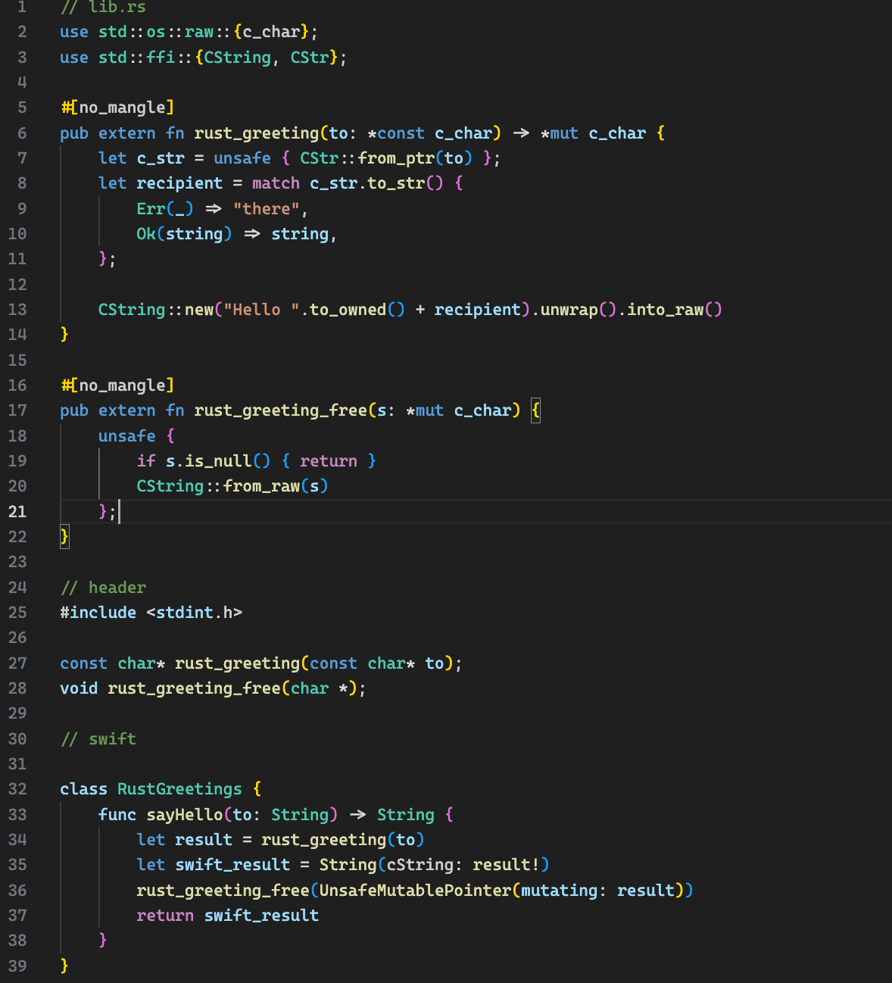
利用Rust重塑移动应用开发
Rust FFI On IOS
Rust targets for IOS
Build the static universal library for different target
Call the function on the swift code
Photo / image / chart

Slide 15
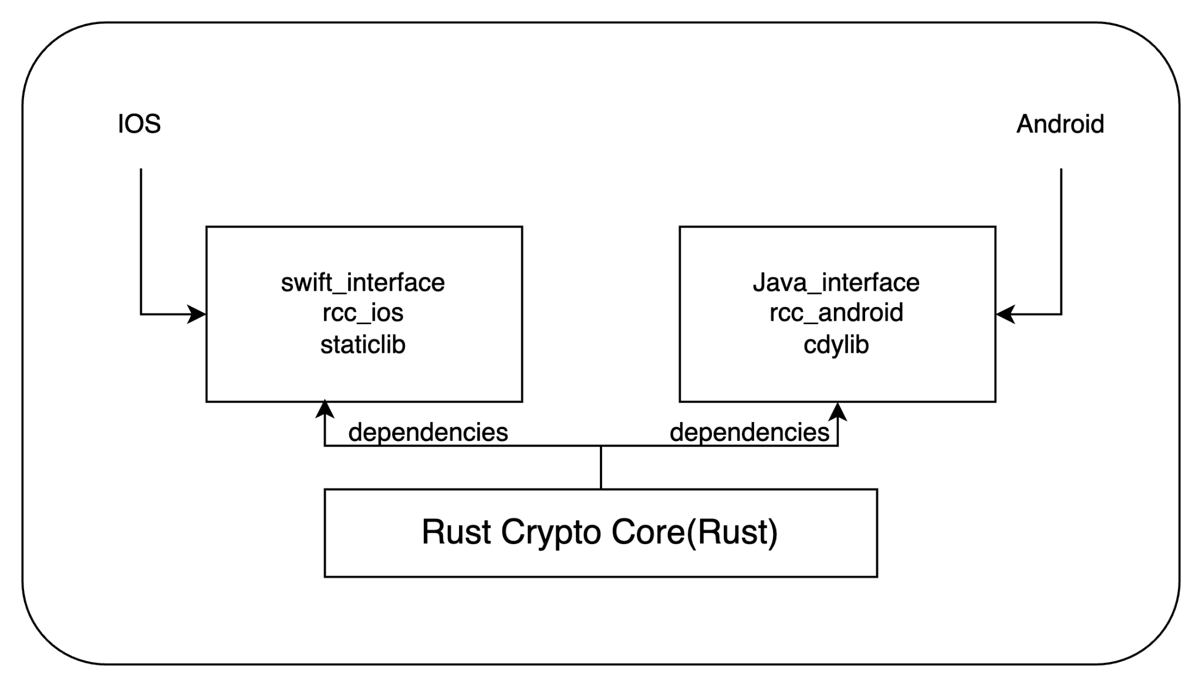
利用Rust重塑移动应用开发
Rust在Keystone业务上的实践
Rust Crypto Core
Photo / image / chart
RCC_android
RCC_ios
https://github.com/KeystoneHQ/rust-crypto-core
https://github.com/KeystoneHQ/rcc_android
https://github.com/aaronisme/rcc_ios

Slide 16
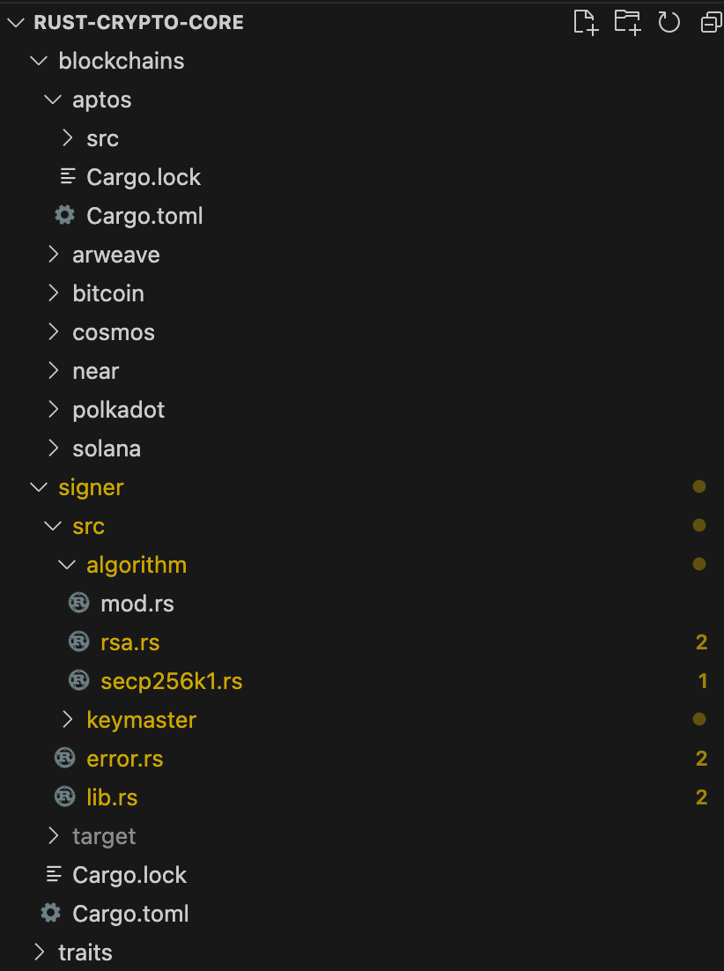
利用Rust重塑移动应用开发
Rust Crypto Core
Core business logic library， can be shared on different platform.
Signer
cryptography support
Blockchain Support
Publish each module as independent package

Slide 17
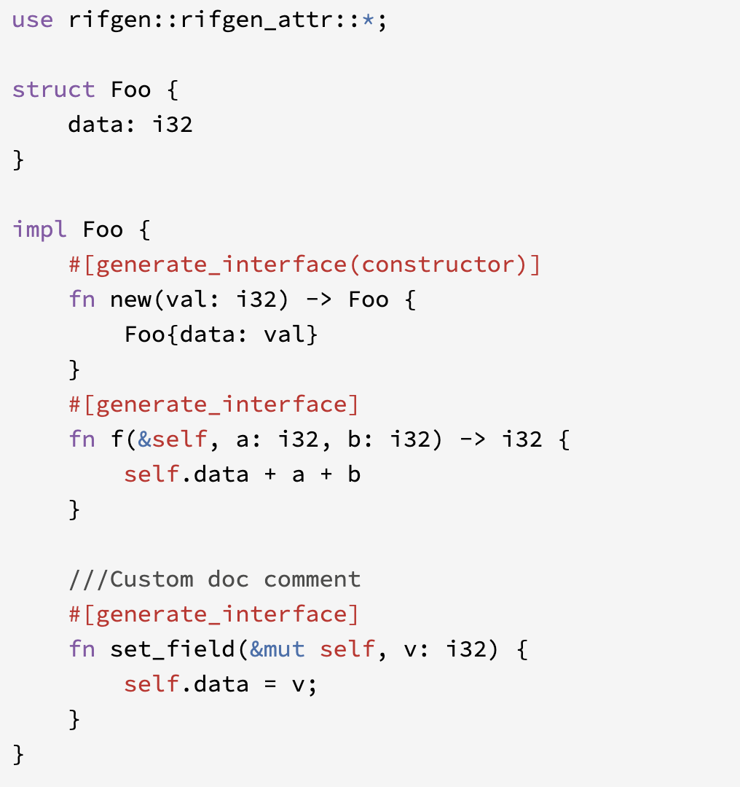
利用Rust重塑移动应用开发
RCC_Android
RCC_Andorid is an rust library which is to binding Rust code into Android application.
Use the crate rifgen, flapigen to generate the java interface for rust code.
Wrap the whole rust code as an independent android library
Photo / image / chart

Slide 18
利用Rust重塑移动应用开发
RCC_IOS
RCC_IOS is an rust library which is to binding Rust code into IOS application.
Use the crate lipo to generate the staticlib for ios application
Use the cbindgen to generate the header file for this library
Introduce the library as linked library into the application

Slide 19
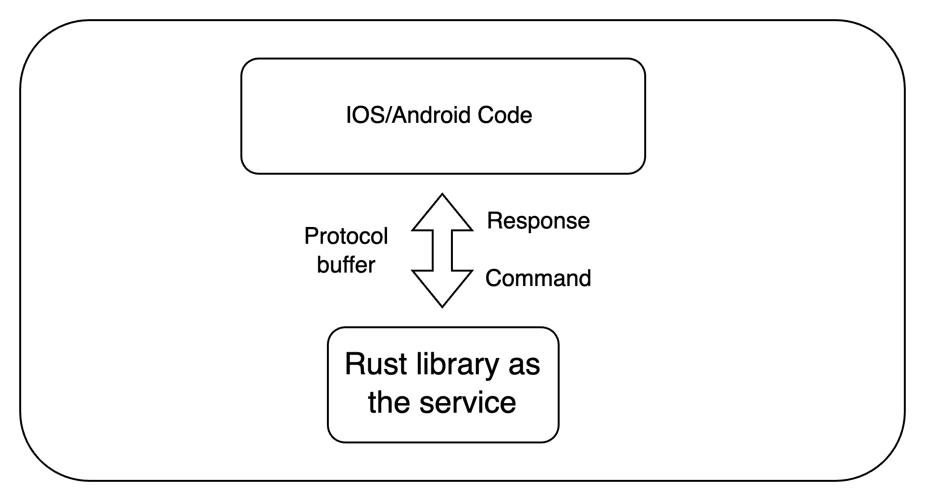
利用Rust重塑移动应用开发
Protocol Buffers
Directly expose the function to IOS/Android?
Hard to maintain
Hard to define the return value
Hard to process the error? Panic? App Crash？
Treat the rust module as an independent service
Command <> Response
Using the protobuf as the data encoding/decoding protocol

Slide 20
利用Rust重塑移动应用开发
Tools
cargo-dinghy
rust-android-gradle
cargo-lipo
android-logger

Slide 21
利用Rust重塑移动应用开发
Summary
Rust's application on mobile platforms is increasingly gaining attention from developers. With its impressive performance, memory safety, and concurrency features, Rust has become an ideal choice for building high-performance mobile applications.
Cross-Platform Support: Rust's cross-platform capabilities allow developers to share code across different mobile platforms. Developers can easily port it to different platforms such as Android and iOS. This cross-platform support reduces development effort and improves code maintainability.
High Performance: Rust provides performance comparable to C and C++. This makes Rust a powerful tool for developing high-performance mobile applications.

Slide 22
Thank you！

